Slide 1


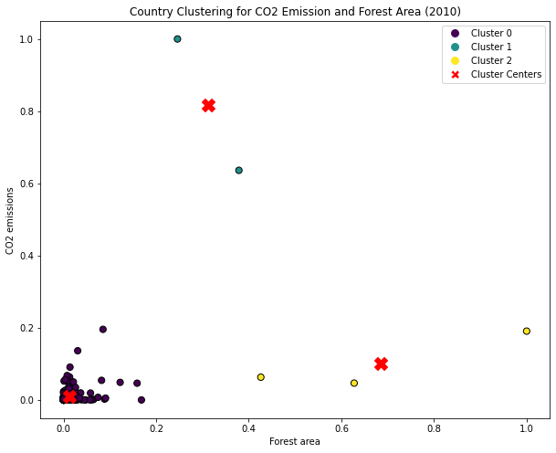
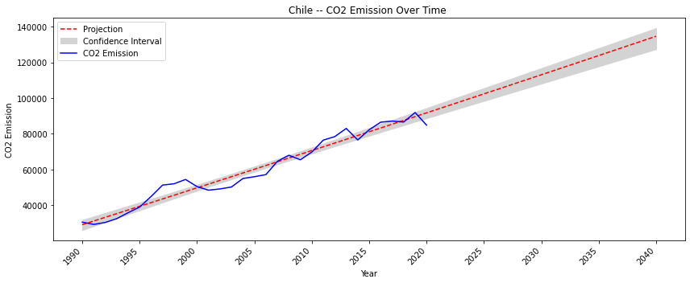
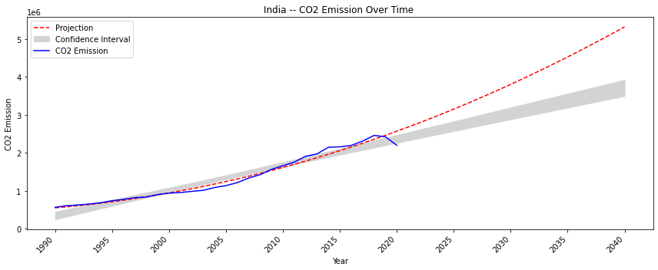
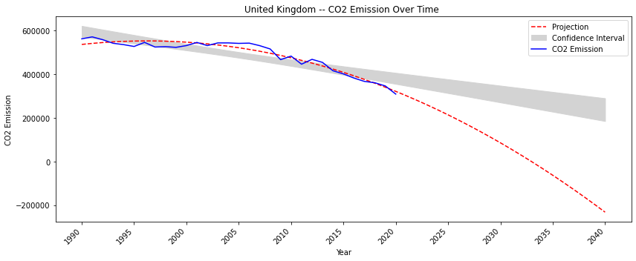
Climate Change Dynamics: Exploring CO2 Emissions and their impact on Global Forest Area
Orevaoghene Otiede (21085158)
GitHub Link : https://github.com/orevs-com/Exercises/blob/main/ADS1_Assignment%203.py
ABSTRACT As countries around the world seek to push the boundaries of technological advances, there has been an awareness call by world leaders on the need to examine the corresponding effects on the environment. It has become imperative that special attention is given to climate change as it has direct with the environment and ultimately, the world population. Food scarcity and low agricultural produce has been one of the major topics of climate change discussions in recent times. Some of the factors responsible for this are the shifting weather patterns, water scarcity and new pests and diseases. This analysis aims to observe the relationship between CO2 emission in parts of the world and the corresponding effects on Forest Areas.
DATASET AND METHOD The data used in this analysis is from the World Bank. Several climate change indicators were analyzed for countries all over the world. The indicators include Agricultural land, CO2 emission, Forest Area, GDP growth and Population. A correlation matrix was used to check relationships between the indicators and further analysis was carried out on CO2 emission and Forest Areas using the scatter plot to graphically explain the relationship. An analysis on historical data for CO2 emission and a corresponding projection was also stated in this project.
CLUSTER ANALYSIS
With focus on the year 2010, we use a scatter plot to show country clusters based on climate change indicators, CO2 emission and Forest Area.
The plot shows a cluster of three clusters with most of the countries in cluster 0. A closer look at cluster 0 shows that there is a mix of different countries including countries with declining CO2 emission (United Kingdom), countries with almost linear CO2 growth (Chile) and countries with rapidly growing CO2 emission (India). These are further influenced by factors like population, government policies and geographical location.
CHILE CO2 EMISION
Being in the temperate regions, Chile has substantial forest areas and while CO2 emission have been increasing over the years, Chile is strategically working to reduce CO2 emission. Projections are within the confidence interval and show an increase by 2040.
INDIA CO2 EMISION
India has a diverse forest ecosystems which is needed for conservation of biodiversity. The population of India, however, has made fighting CO2 emission an uphill task. India stands as one of the highest countries with CO2 emission. Projections are outside the confidence interval but show an increase by 2040..
UNITED KINGDOM CO2 EMISION
The United Kingdome does not have much forest area compared to India and Chile but have shown steady reduction of CO2 emission over the years. This is due to cleaner energy sources from coal and other interventions. The projections show that by 2040, the United Kingdom will be a leading country with close to zero emission.
CONCLUSION The study shows that CO2 emission is a major contributor to the world's ecosystem with particular emphasis on the forest area. As more countries develop polices to reduce CO2 emission, we find that we have a greener planet and a more stable ecosystem.

